Slide 1

FOVEA
Flexible Ontology Visual Event Analyzer
Aaron Steven White · University of Rochester · HLTCOE WIP Seminar · 6 Nov 2025
Live demo: demo.fovea.video
Notes:
I'm going to talk about FOVEA—Flexible Ontology Visual Event Analyzer—which is a video annotation platform we've been developing to support SCALE2026 planning efforts around video understanding. This is very much work in progress, so I'm looking forward to feedback and discussion.
There's a live demo at demo.fovea.video if you want to play with it. Not all features are working yet–specifically, the self-hosted model services are close but not quite there–but it gives you the gist of the manual components of the interface. I’m happy to get feedback on things that are broken or not working as you might expect.

Slide 2
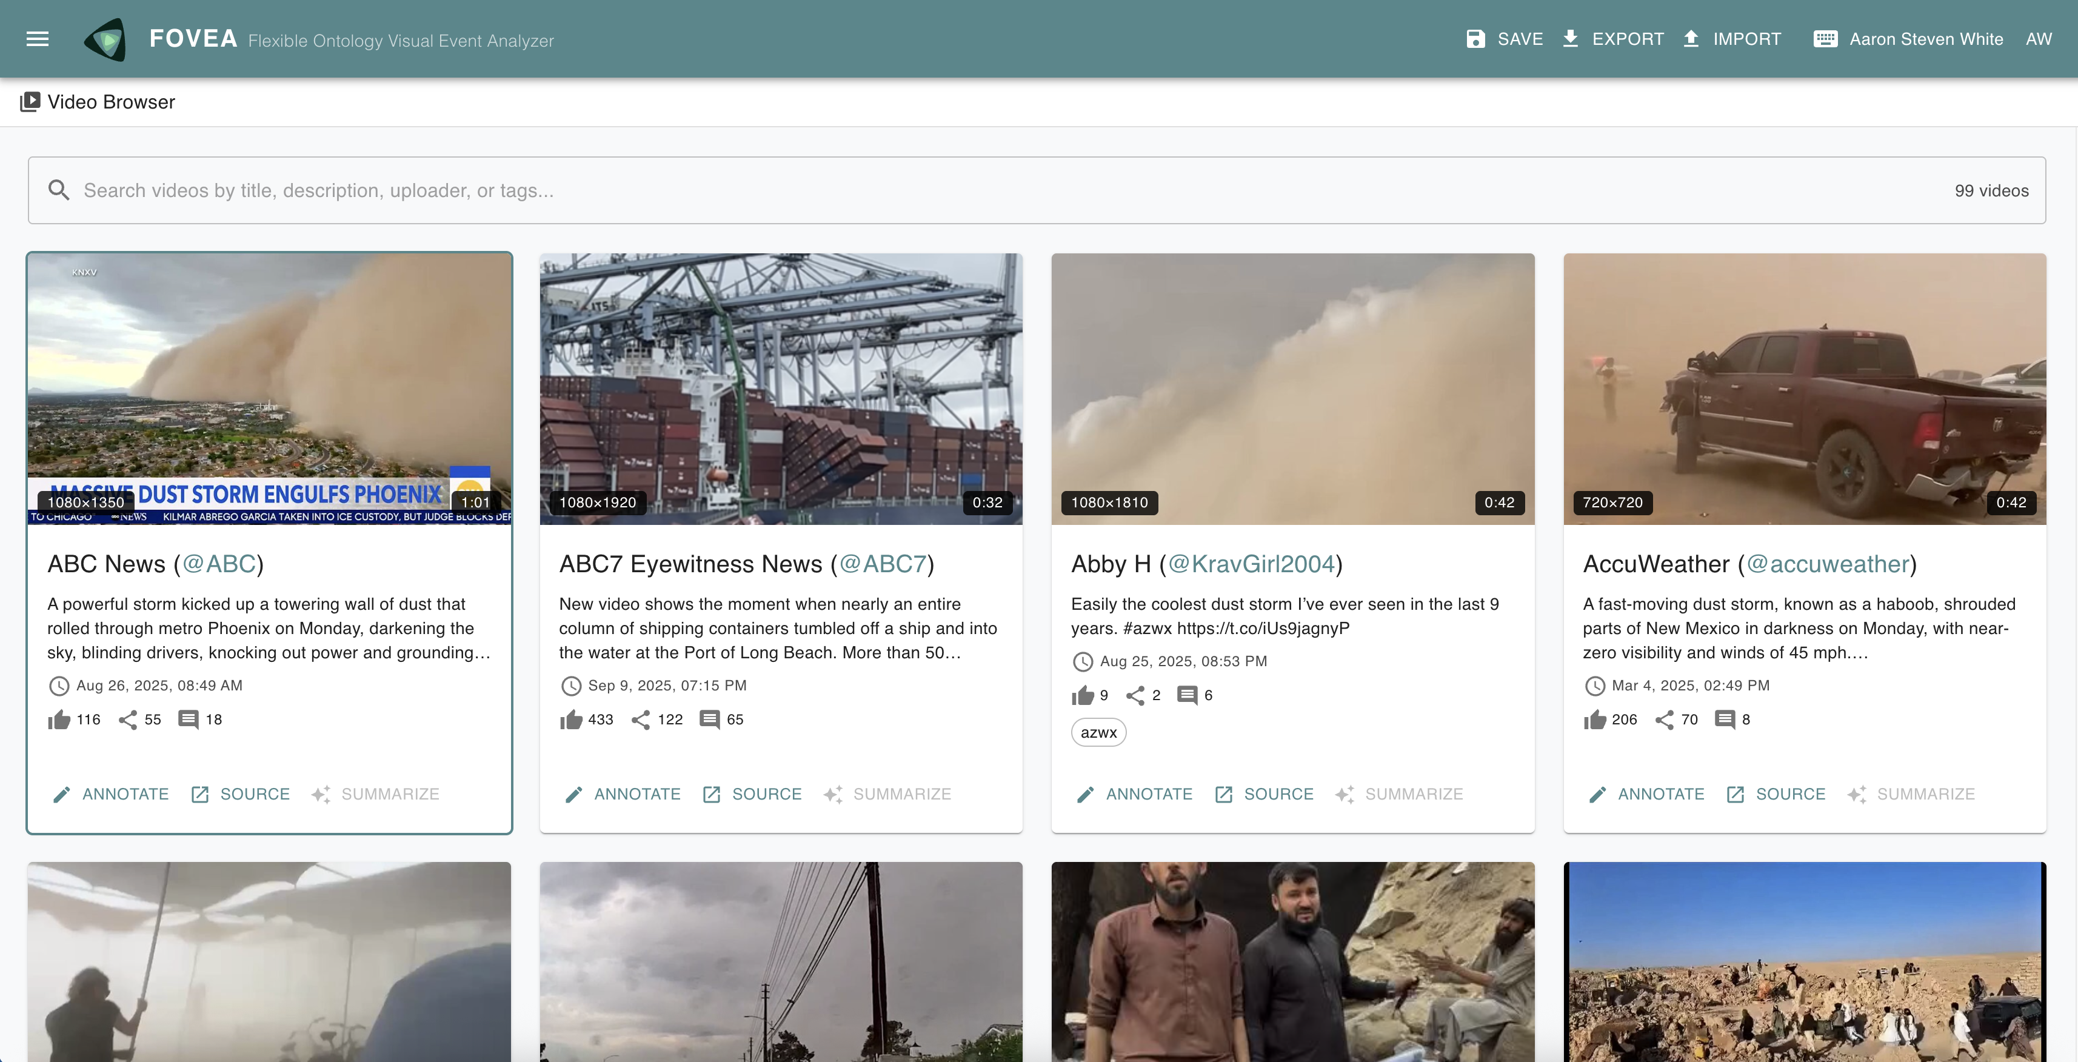
Notes:
FOVEA is a web-based platform for annotating video with custom ontologies. We built it to support SCALE2026 planning efforts—specifically around video understanding and the problem of how different analysts need different interpretive frameworks for the same video data.

Slide 3
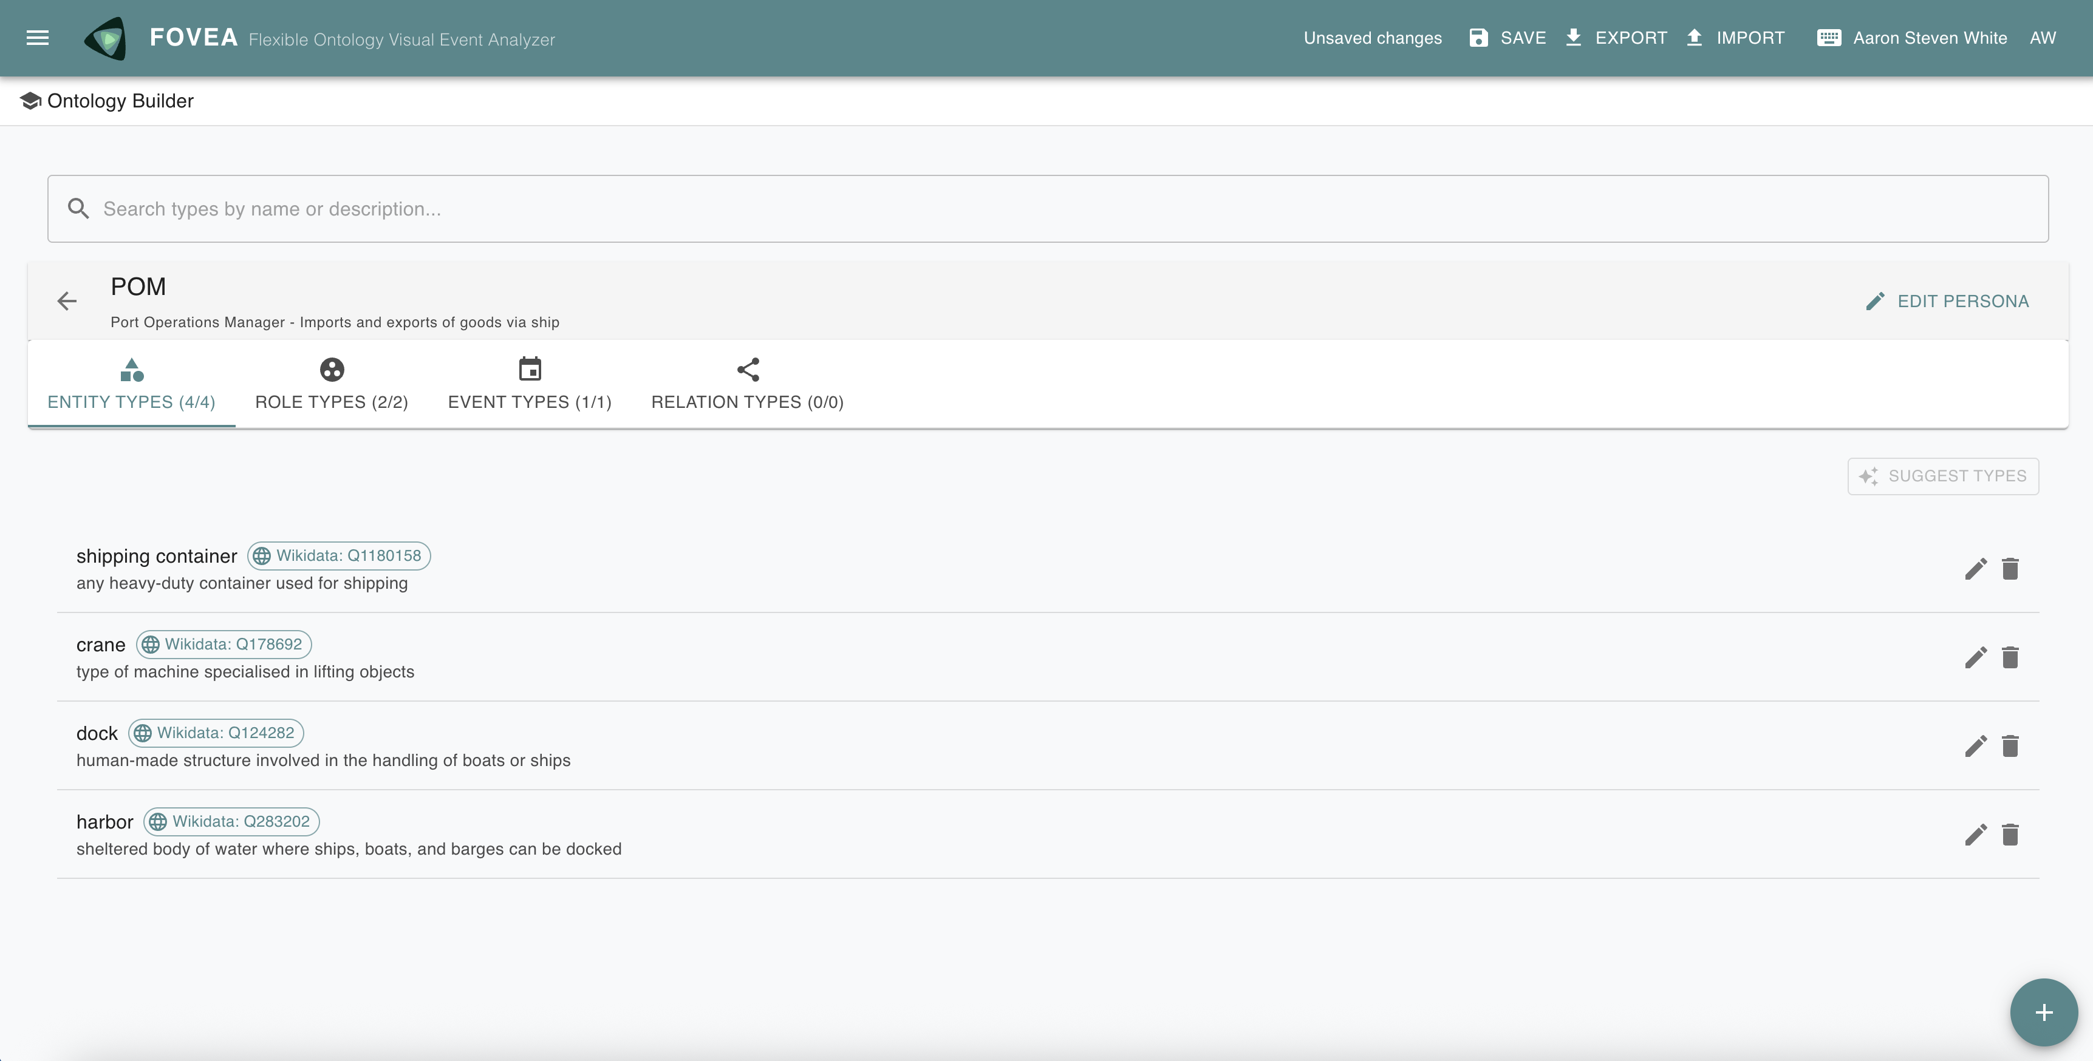
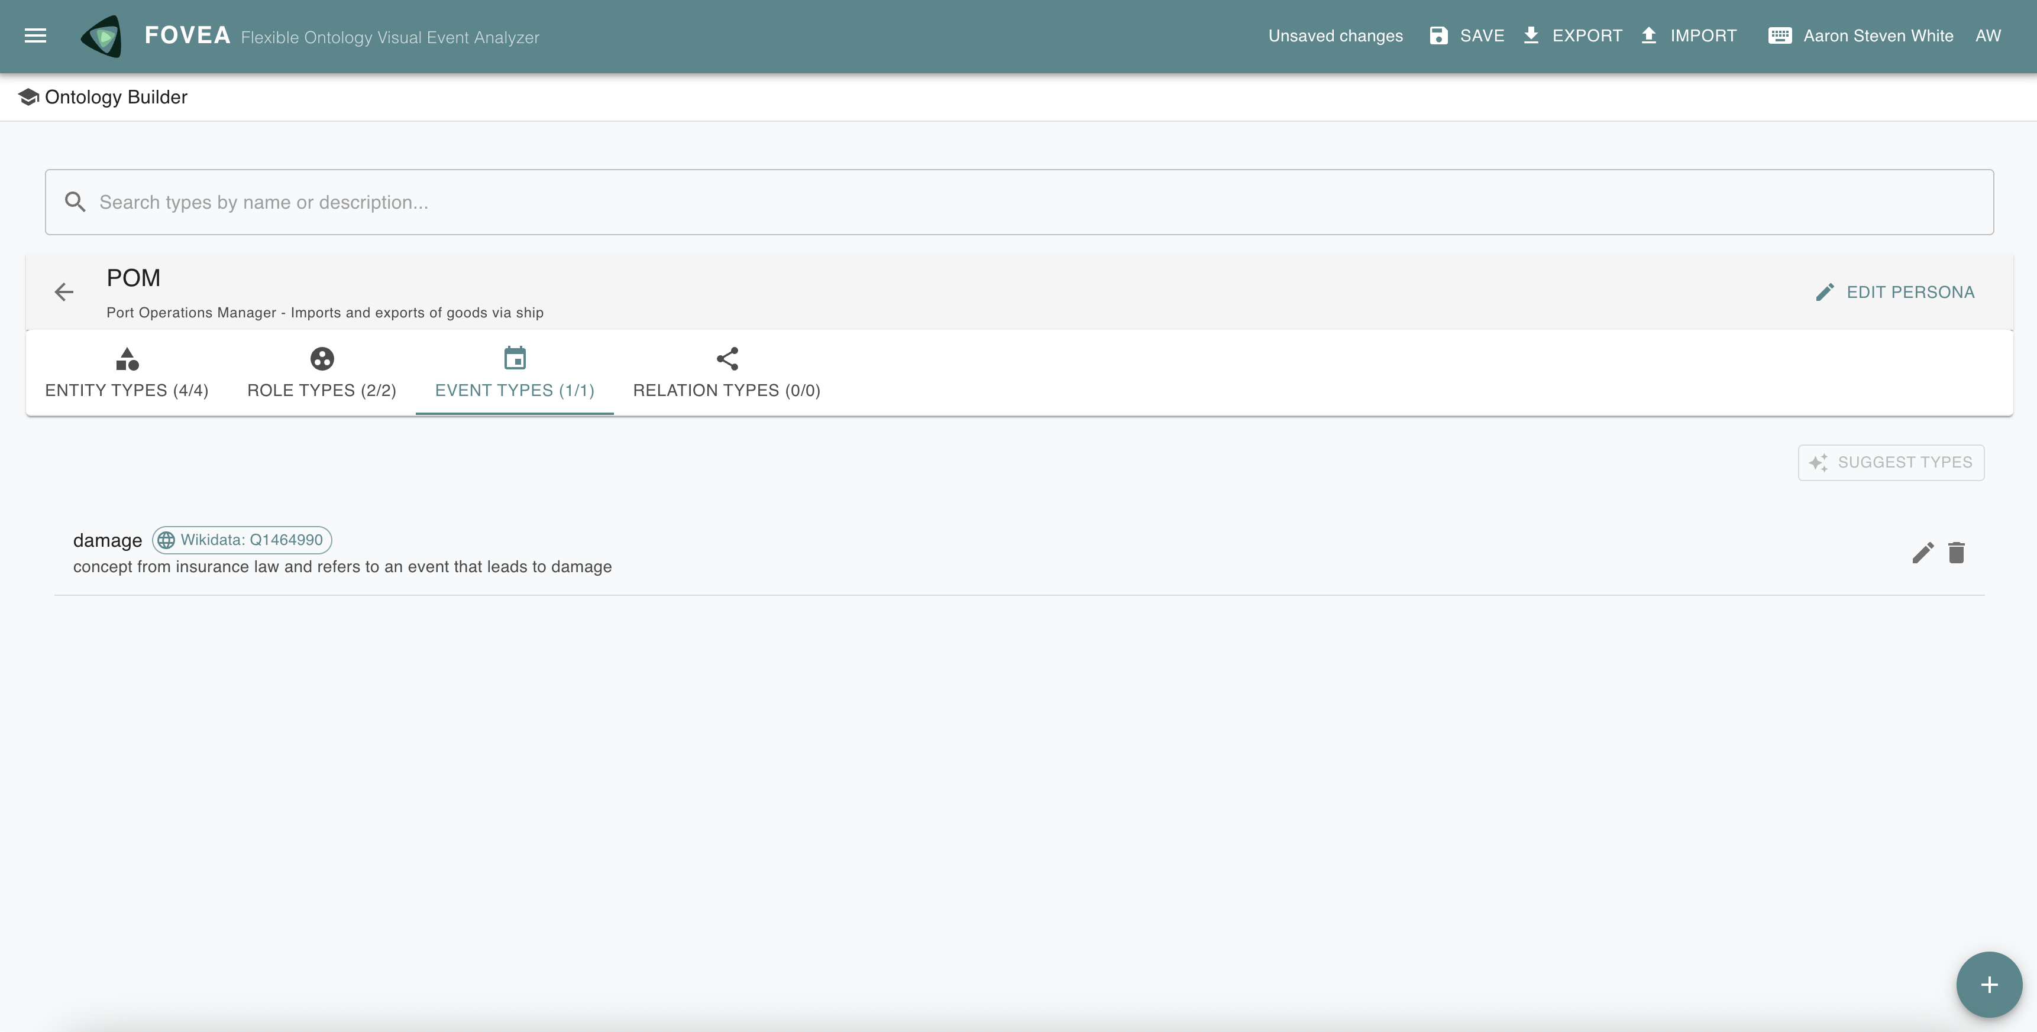
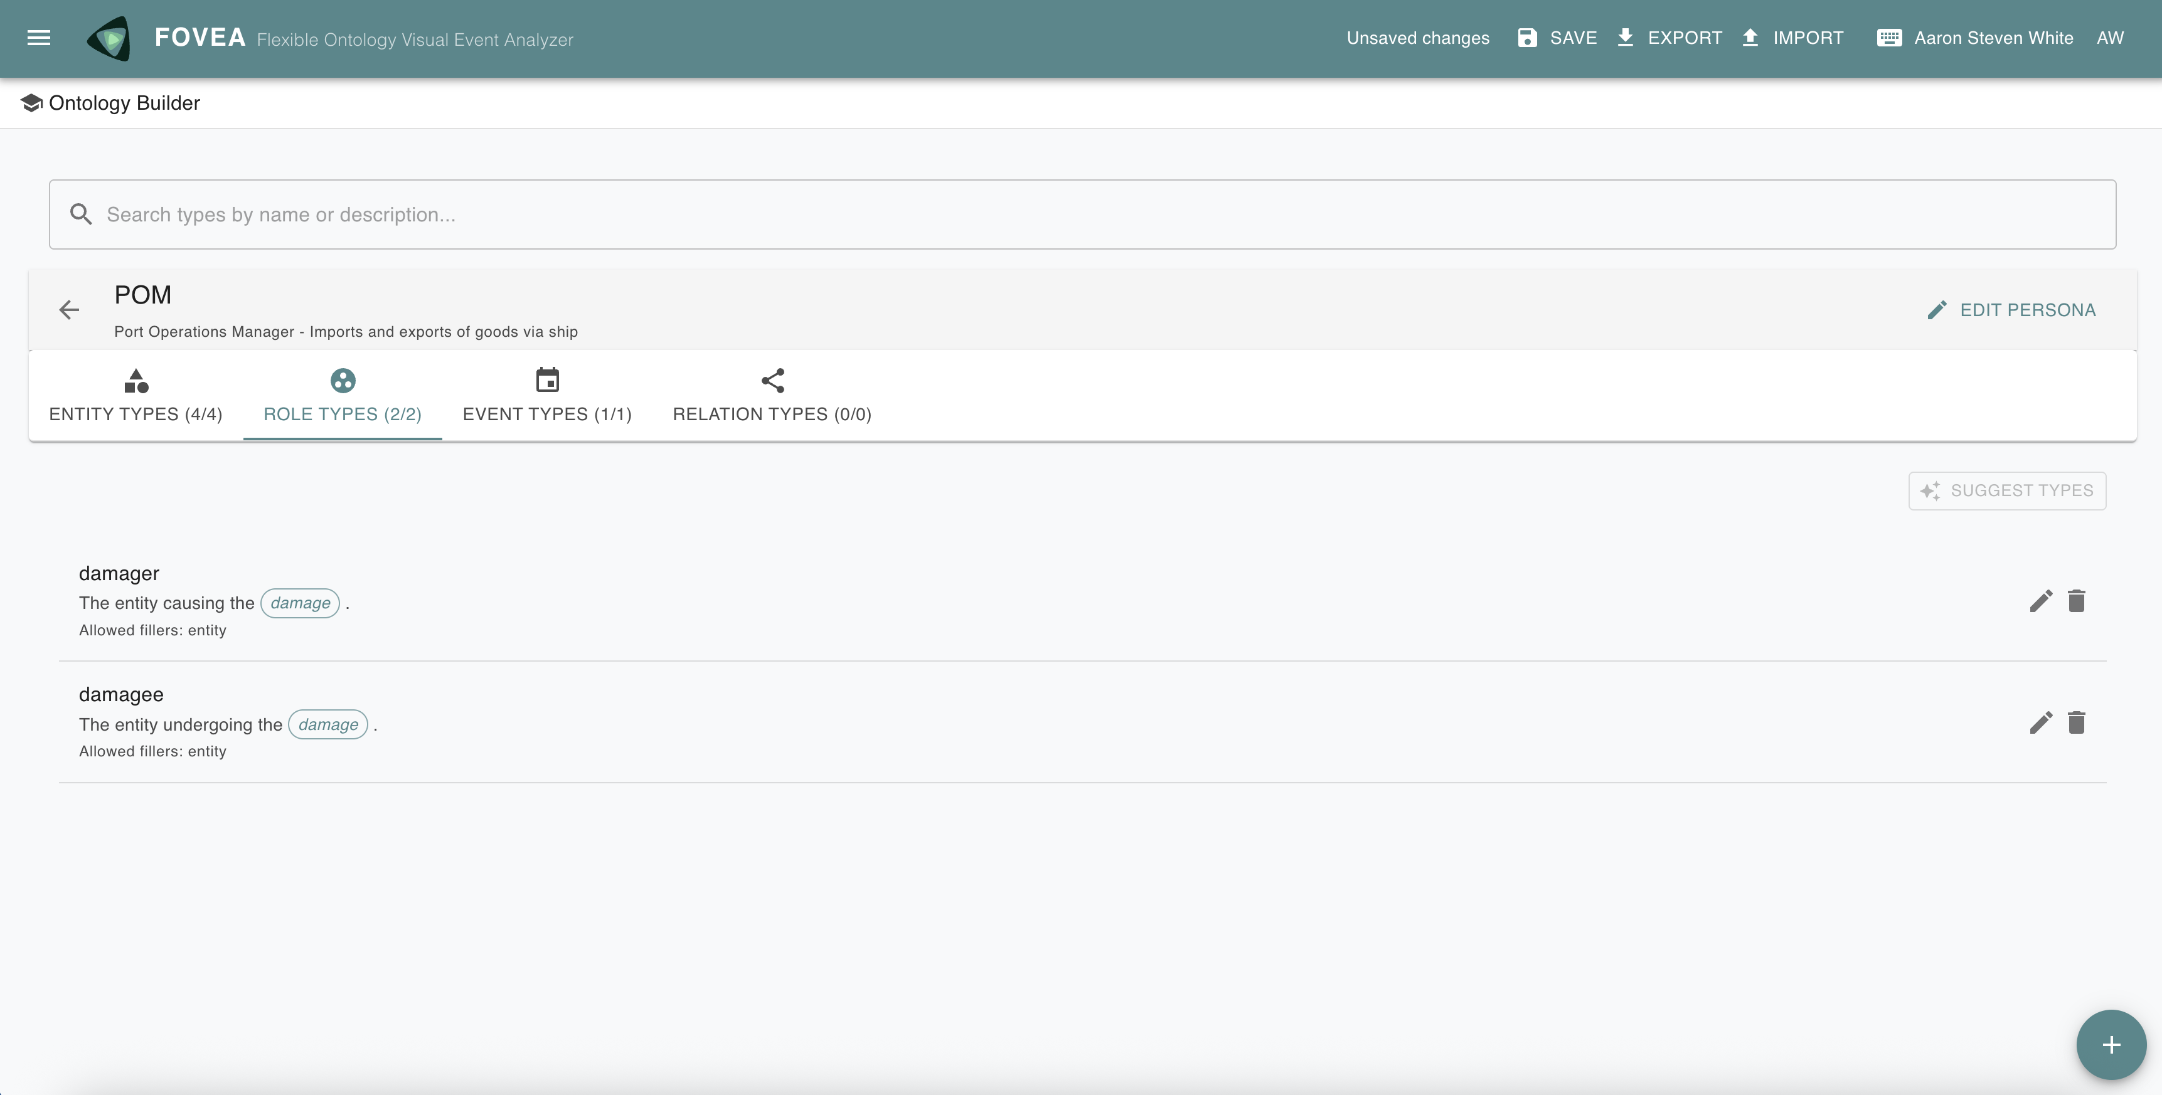
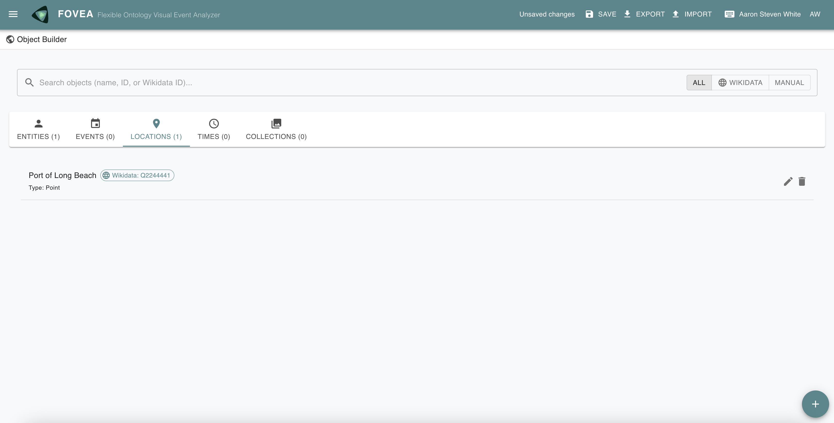
Notes:
The basic workflow is: you define entity types, event types, and role types, or even specific locations, entities, and events…

Slide 4
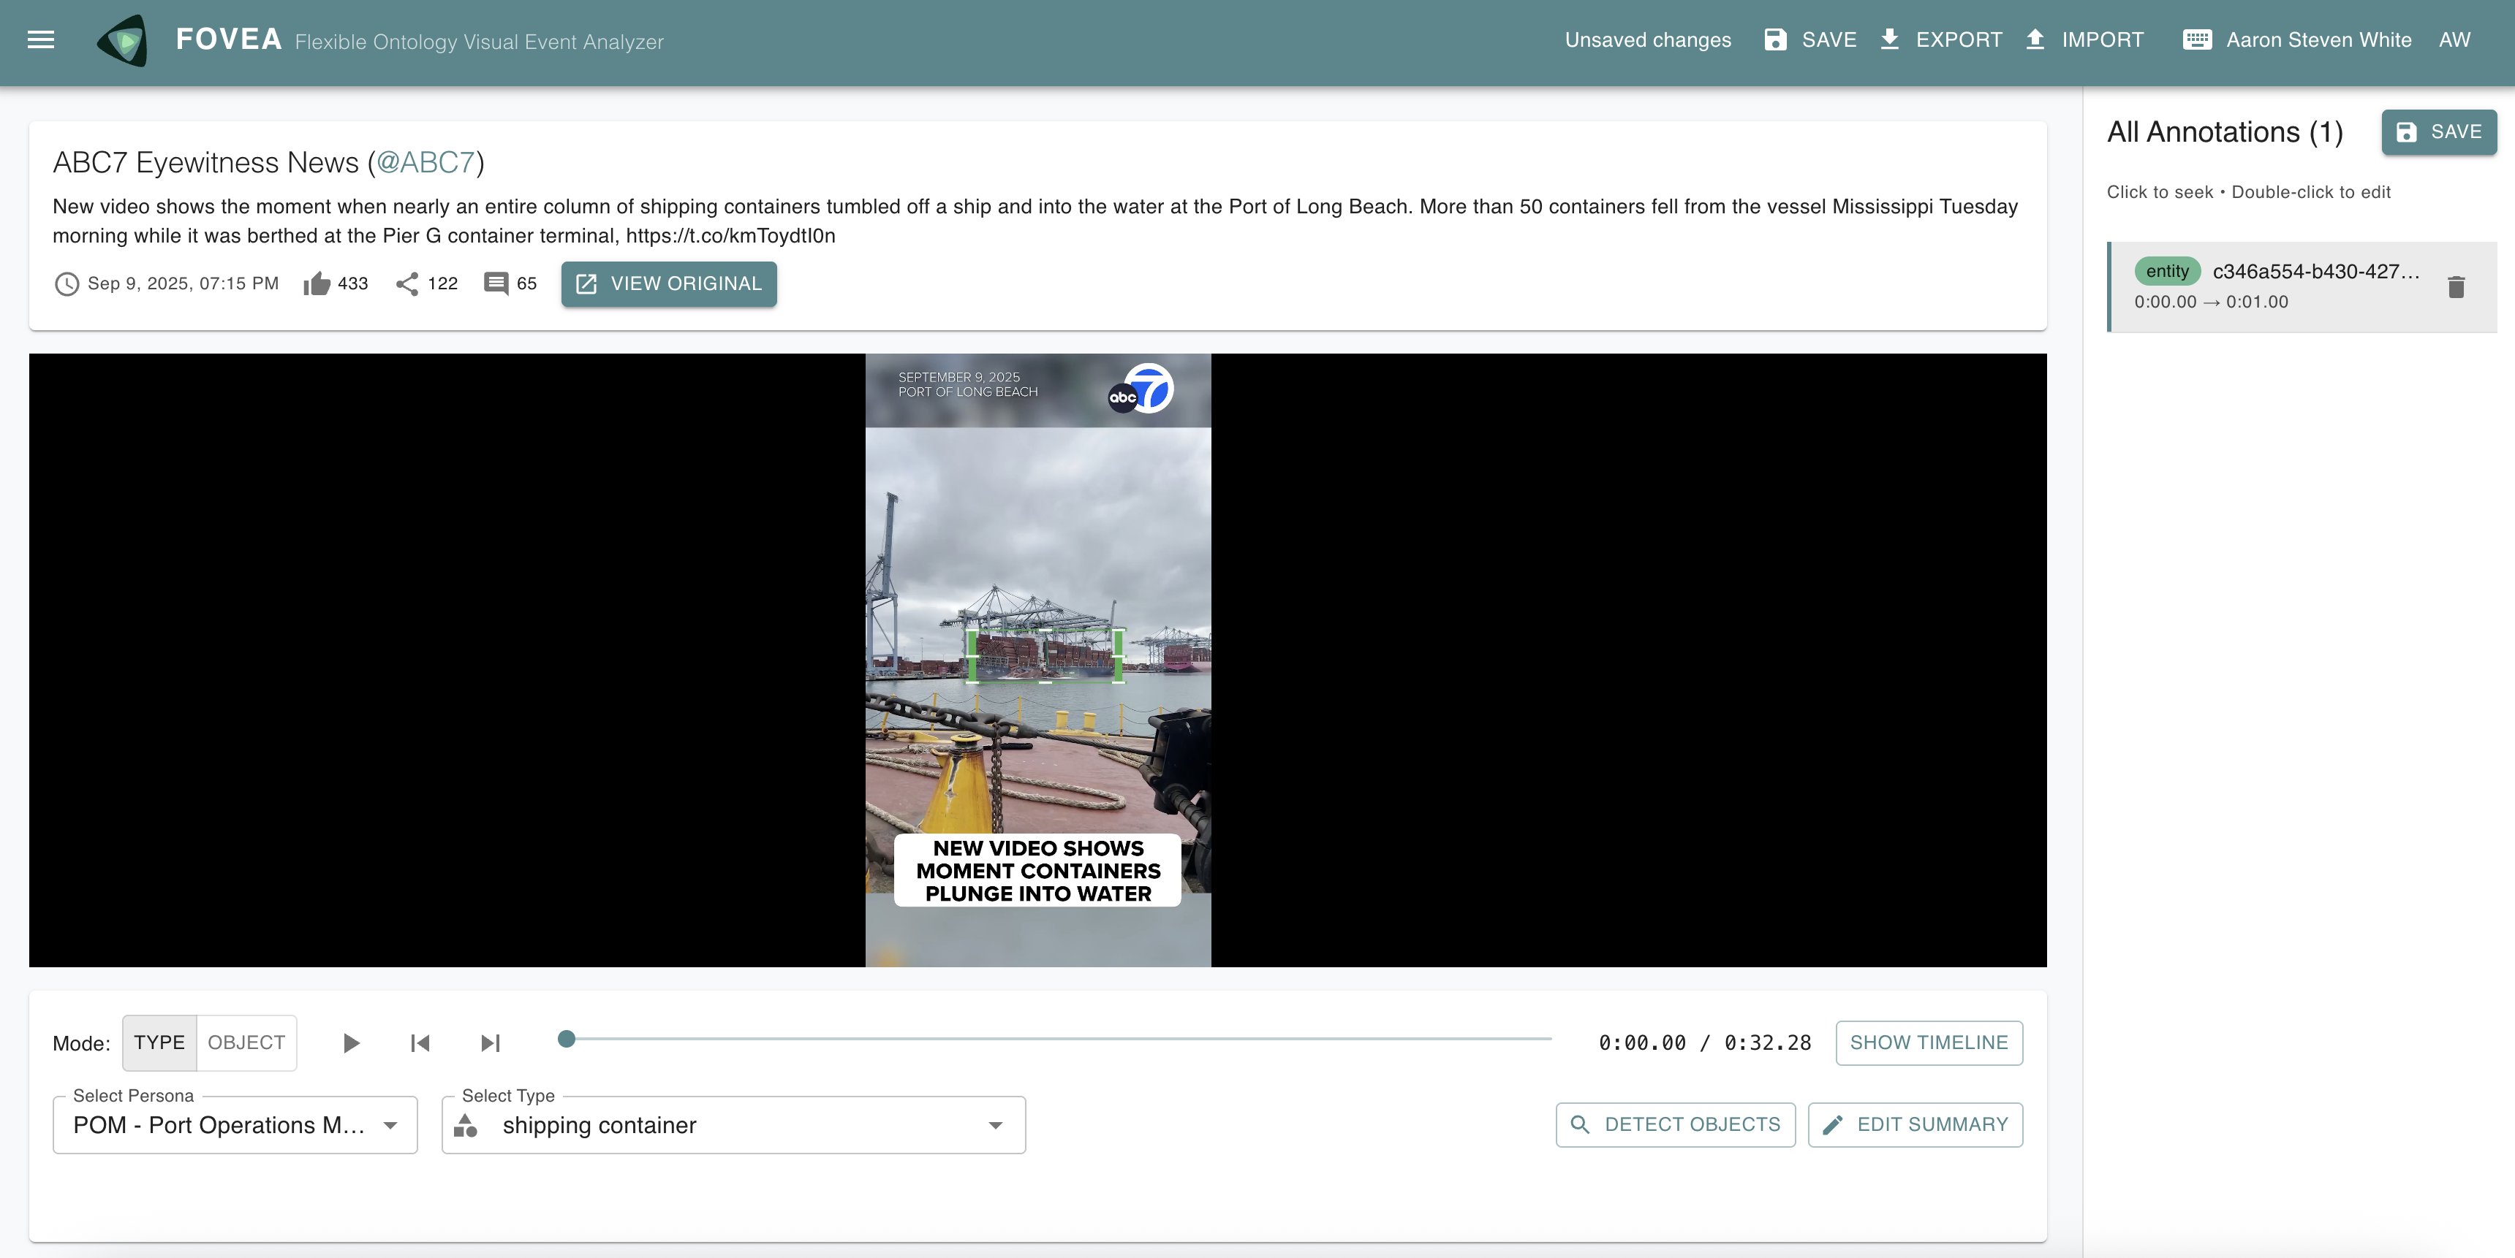
Notes:
…then you draw bounding boxes on video frames and link them to your ontology.

Slide 5
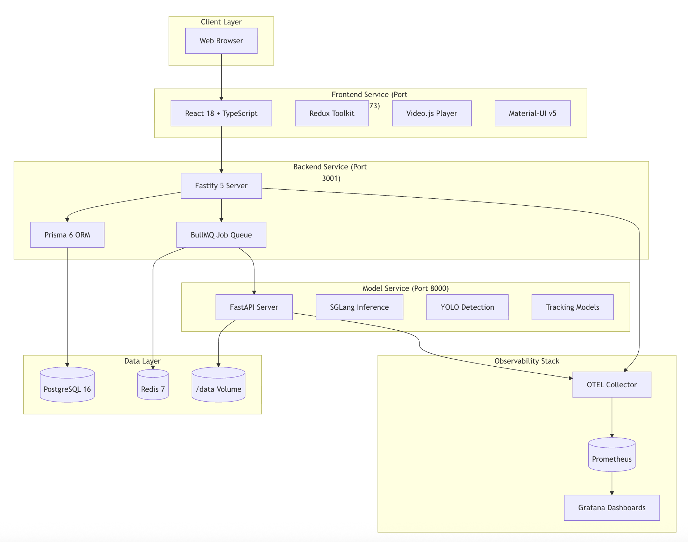
Notes:
The architecture is straightforward—React frontend, Fastify backend on Node.js with PostgreSQL, and a FastAPI service for model calls. Everything's TypeScript and Python. We're using BullMQ with Redis for job queuing when we call out to VLMs or LLMs.

Slide 6
Notes:
The main idea that FOVEA is built around is that different analysts need different interpretive frameworks for the same video. That's the motivation for everything else I'll show you.
Say you have video of an incident at the Port of Long Beach where shipping containers are falling from cranes into the water.
An emergency response coordinator watching that video is looking for immediate hazards—are there people in the impact zone? Is there fire or smoke? What resources need to deploy?
An environmental analyst watching the same video is concerned with contamination—what's in those containers? Are hazardous materials entering the water? Where's the spill spreading?
A port operations manager is thinking about recovery—which cranes are damaged? Is the shipping channel blocked? How long until we can resume operations?
Same video, same pixels, but completely different analytical priorities. Traditional annotation tools force you to pick one ontology that everyone uses. Or you build separate projects for each perspective, which means you can't compare across interpretive frameworks and develop reports from multiple fine-grained perspectives.

Slide 7
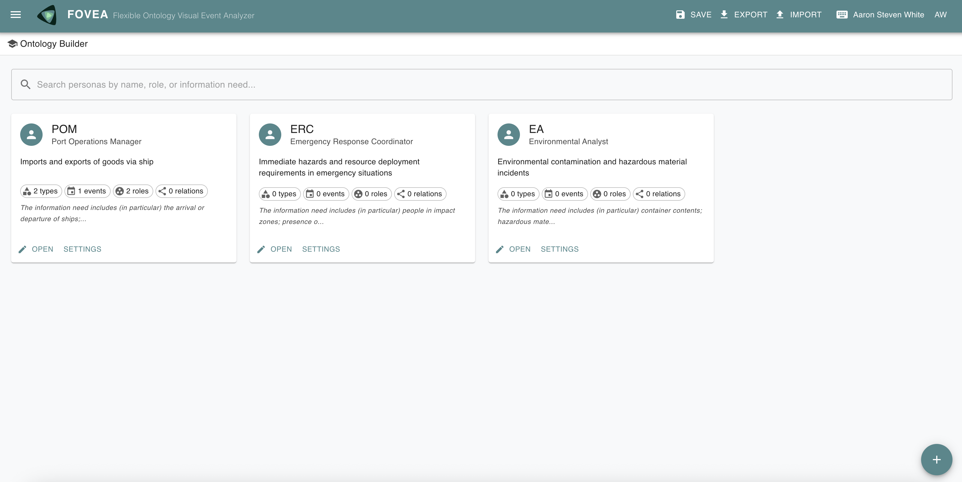
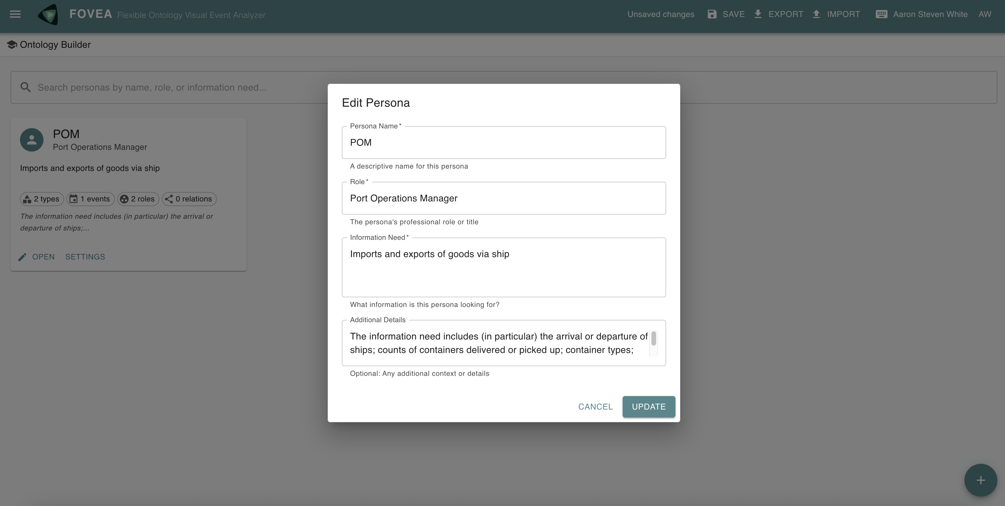
Notes:
Our approach is to make the analyst's role and information needs explicit. You define a persona: who you are, what information you need. Then you build an ontology tailored to that persona.
Multiple personas can coexist in the same workspace. The same shipping container can be annotated as "40-foot standard container with Maersk logo" by the port operations manager and "displaced cargo—structural hazard" by the emergency response coordinator.

Slide 8
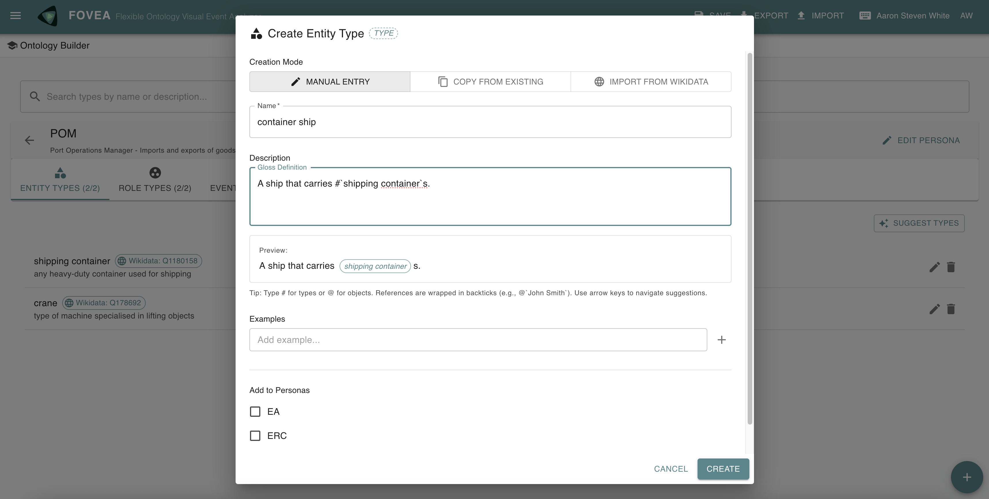
Notes:
One important way this annotation tool differs from others in that normally you have to design your complete ontology upfront, then switch to annotation mode. But ontology development is iterative. You discover that you need new types while you're annotating.
In FOVEA, you can edit entity types, event types, and role types while you're annotating. No mode switching. So suppose you realize you need a ”container ship" entity type? Add it right there, keep working.
We do schema validation to maintain data integrity—if you change a type definition, we check that existing annotations are still coherent. But the point is that ontology development and annotation happen simultaneously.

Slide 9
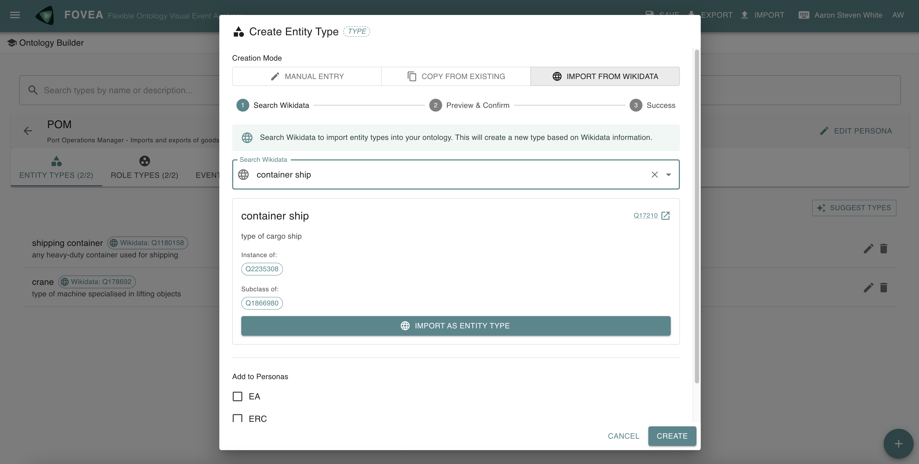
Notes:
We also wanted to reduce the cold-start problem for building ontologies. So we added one-click import from Wikidata.
You search for "container ship," you get Wikidata Q17210 with its full description and relationships. You can import that directly into your ontology. You can then refine the definition to match your specific analytical needs, but you maintain the link to Wikidata.
This gives you linked data grounding without forcing you to use Wikidata's ontological commitments wholesale. You get the benefits of external knowledge bases while keeping the flexibility to build persona-specific ontologies.

Slide 10
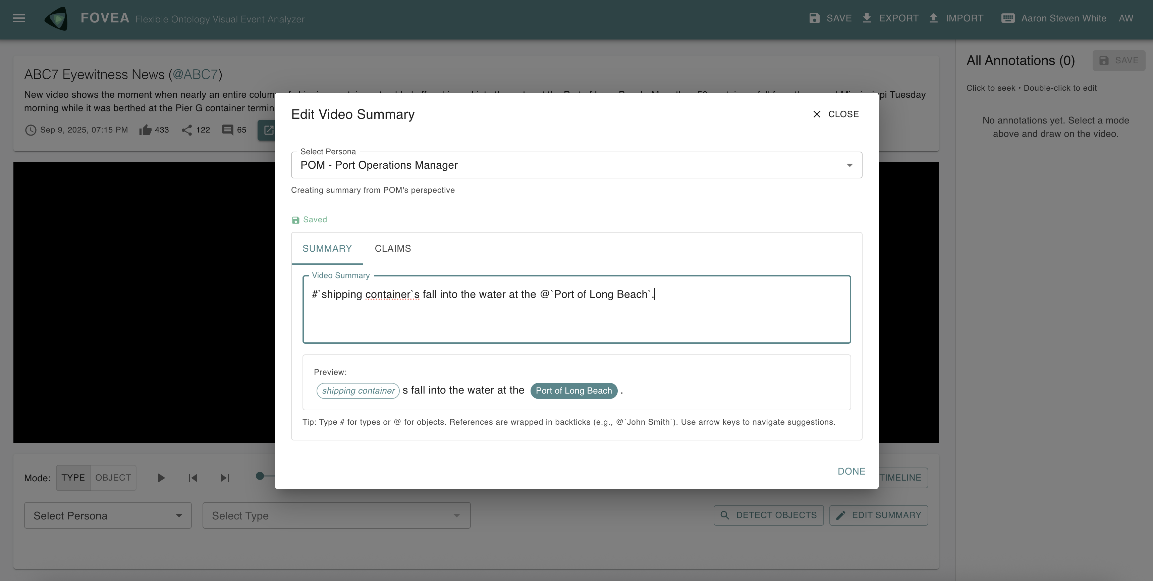
Notes:
For report writing, we've integrated two kinds of AI assistance. First: video summarization using Vision Language Models.
The key here is that summarization is persona-aware. When you request a summary, it uses your persona's role and information needs to construct the prompt. So the "Tactically-Oriented Analyst: Imports/Exports" persona gets summaries focused on ship arrivals, container counts, vehicle types—exactly what they specified as their information need.
The groundwork is also there to support audio transcription with speaker diarization. And we have four different strategies for fusing audio and visual information.

Slide 11
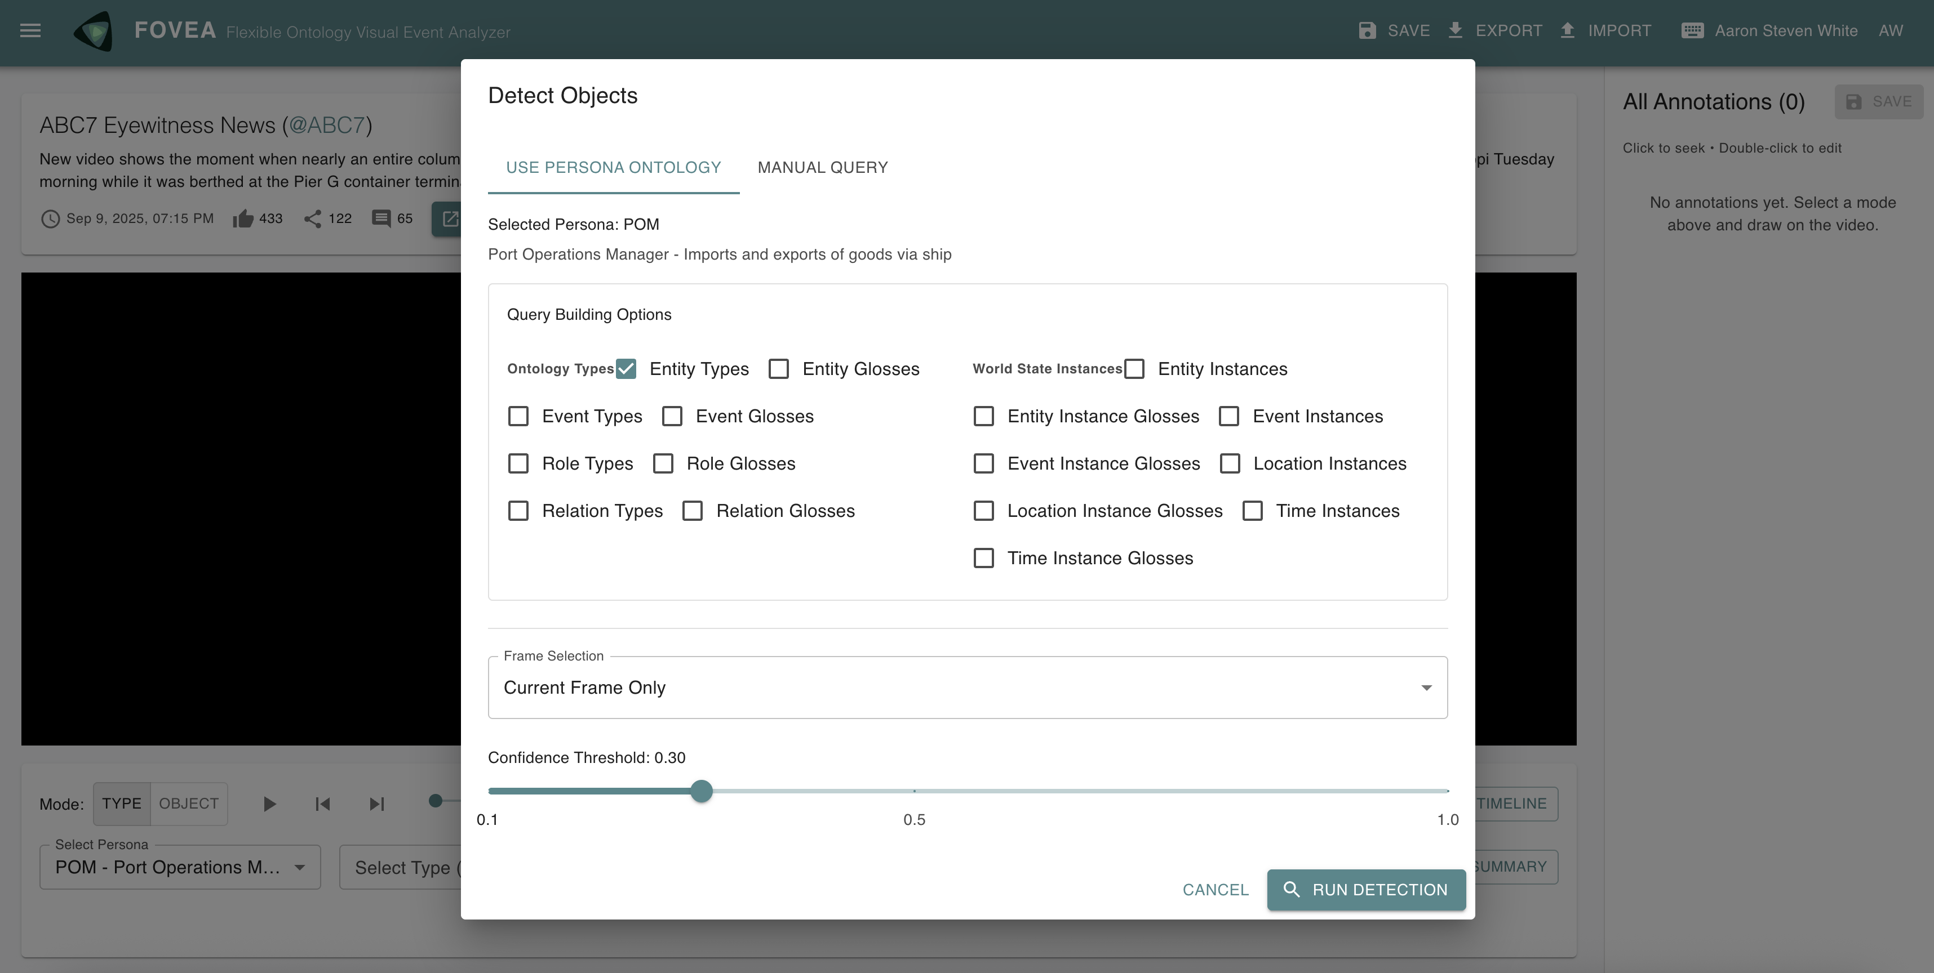
Notes:
The groundwork is also there to handle object detection, with support for YOLOv8 and GroundingDINO for detecting and localizing entities in frames. The groundwork is als there to support object tracking—using ByteTrack and other algorithms to follow entities across frames once they're detected.
This all runs as background jobs because model calls can be slow. You can use local models if you have GPU (which is currently what’s running on the demo), or call out to an external provider by setting API keys.

Slide 12
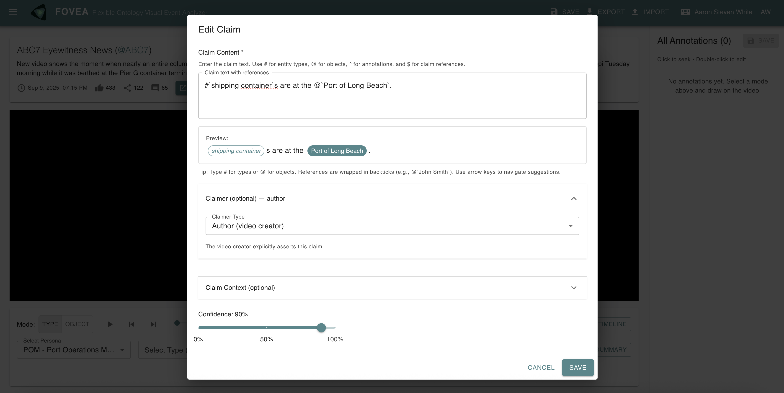
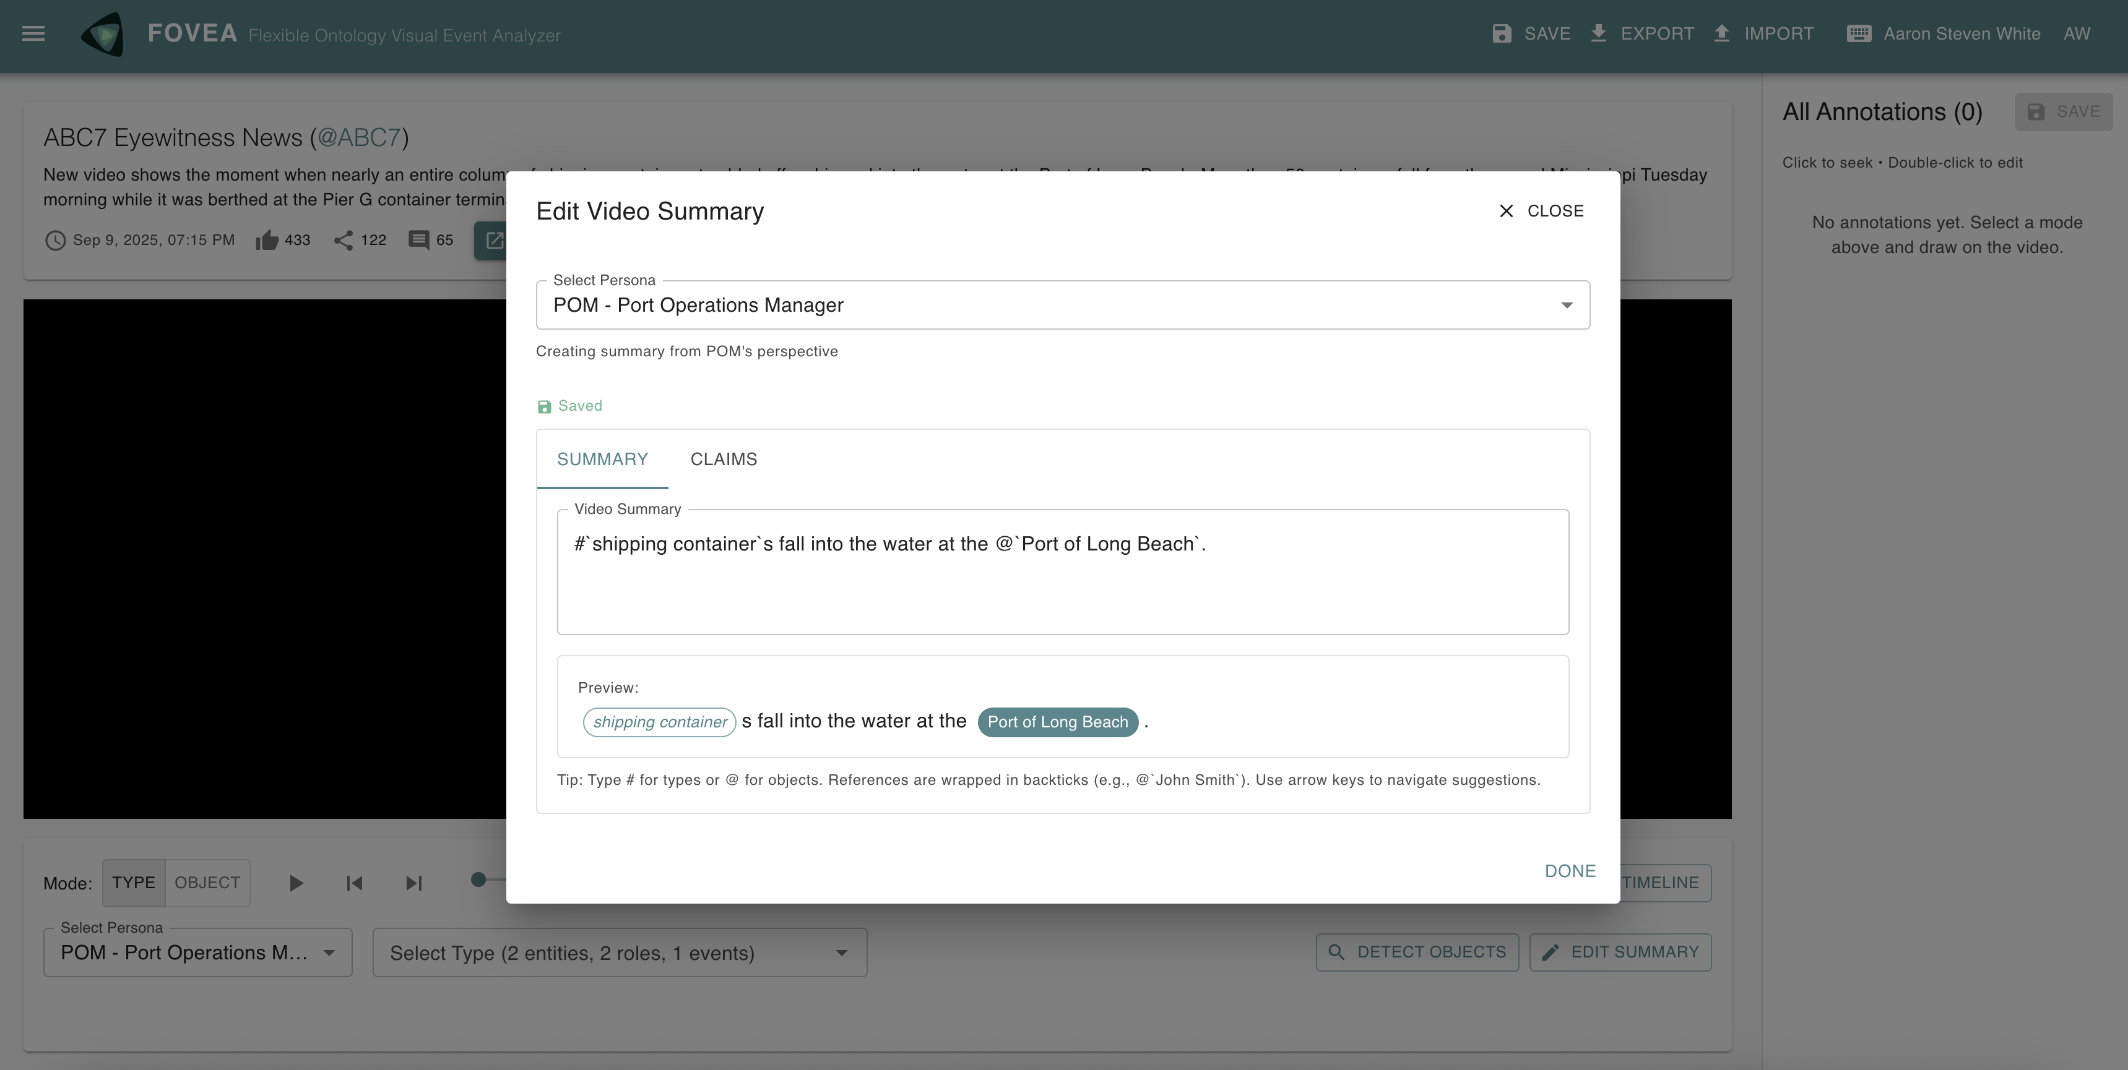
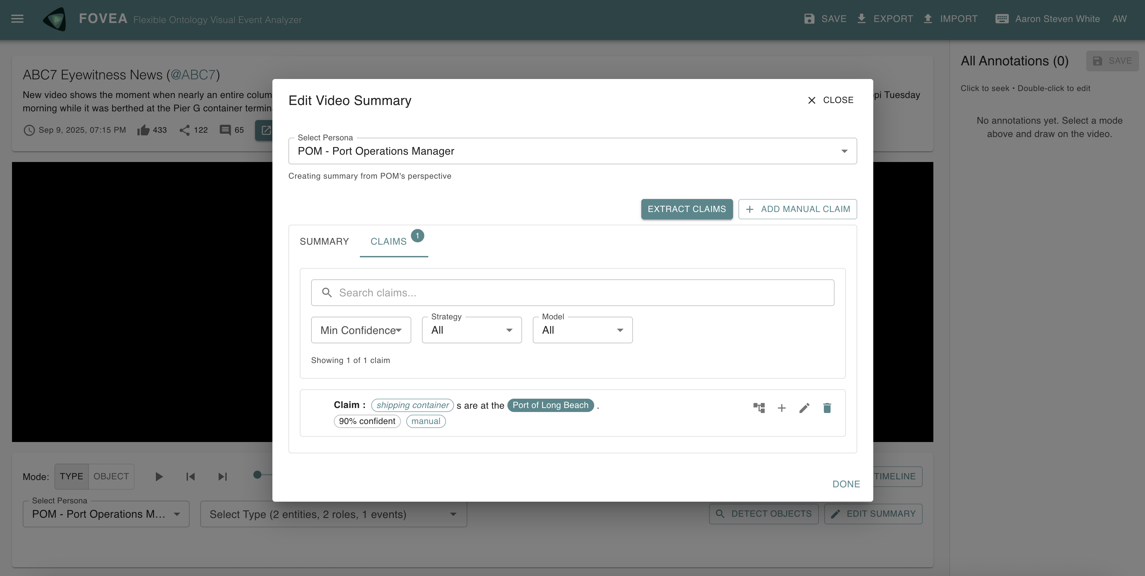
Notes:
The second piece of AI assistance is for extracting structured claims from summaries.
Once you have a summary, you can extract and edit atomic factual claims. These are hierarchical—claims can have subclaims. They also have typed relations: one claim supports another, contradicts it, refines it.
The groundwork is also there to support synthesizing summaries from claims.

Slide 13
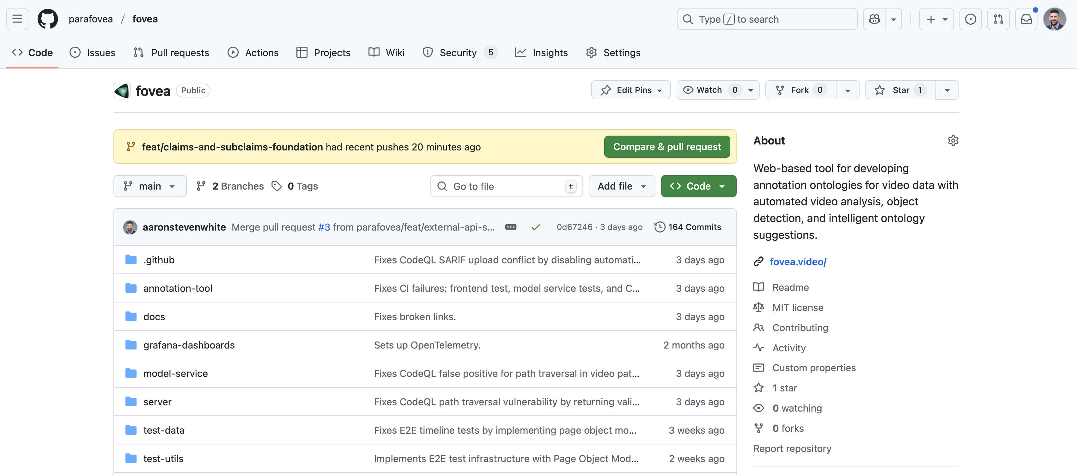
github.com/parafovea/fovea
Notes:
That's the overview. The code is MIT licensed, it's on GitHub. I’m happy to receive any feedback on the interface or interesting ways to integrate further model services.

